Slide 1


Team Details
  Team name: Binary Minds
  Team leader name: Mohammed Iliyas, Rinkle Agrawal
  Problem Statement: Every release, product managers have to make sure nothing breaks CCPA rules, but nobody can check every guideline by hand. So a dark pattern slips into the live site, and the company ends up with a fine and a bad name.

Slide 2

Brief about the idea
!
The problem
✓
The solution
India’s CCPA banned 13 dark patterns in 2023, including drip pricing, basket sneaking and false urgency.
Enforcement is live: Zepto fined ₹7 lakh, McAfee ₹1 lakh; in June 2025 all e-commerce platforms were told to self-audit.
Audits are periodic, manual, time consuming while checkout and pricing flows release continuously.
A flow can drift out of compliance with the next release, unnoticed until someone else spots it.
Tests your live store like a real customer would, before every single release.
Flags each dark pattern with a screenshot and the exact CCPA rule it breaks.
Suggests a fix, re-tests the store, and shows the new compliance score.
Saves every run, so you always have proof of compliance ready to show.
5
<=50 Lacs
5 of 13
1
AI agents, one pipeline
Savings from penalty for violation
CCPA dark patterns tested currently
Single click pipeline run to test compliance

Slide 3
Opportunities
Why now: CCPA banned 13 dark patterns (2023) and enforcement is live; in June 2025 it directed all e-commerce platforms to self-audit. Penalties go up to ₹10 lakh, and ₹50 lakh for a repeat contravention.
1
How different is it from existing ideas?
2
How will it solve the problem?
3
USP of the proposed solution
Consultants and page scanners audit periodically, one page or screenshot at a time. Dark patterns hide between pages.
Verdicts rest on the official CCPA text and live data (“Only 3 left!” vs 178 in stock).
A plain AI chat prompt can give one opinion with no systematic output. TrustLens runs the same journey every release, so results can be compared between versions and audit.
TrustLens plays the full customer journey in a real browser and compares checkpoints, identifying dark patterns.
Proves each finding with screenshots and a cited CCPA rule.
Generate a full complaince report covering every pipeline stage
Stores each run as a trail compliance and product teams can audit.
Prove, cite, and suggests fix in one pipeline, not five separate tools. .
Grounded verdicts: official CCPA text retrieved at run time, not left to model memory.
Two fixes per finding: a statutory change with code fix, and a conversion-friendly alternative.
Repeatable by design: the same scripted journey every run, so release-to-release scores are fair and consistent.

Slide 4
List of features offered by the solution
1
2
3
4
Agent Dashboard
Customer journey simulation
Specified Clauses
Dual fixes
Pick the version, start a run and watch the five stages finish live. Select respective agent for screenshots, findings and reasoning.
An agent shops your live store like a real customer, from catalogue to cart to checkout to cancellation, capturing a screenshot at every checkpoint.
Every ruling quotes the CCPA 2023 definition and legal basis, with a confidence level for human review.
A compliance change with code fix, paired with an ethical, conversion-friendly alternative.
5
6
7
8
Run comparison
Compliance trail
Jira Ticket hand-off
Dark Pattern Guide
Two runs side by side post fix implementation with before and after comparison and the score change.
Score history across releases, and a downloadable PDF report.
One click drafts a Jira issue pre-filled with the clause, evidence and fix.
All 13 CCPA patterns with excerpts and enforcement precedents; the 5 tested today are marked.

Slide 5
Process flow diagram or Use-case diagram
Operator
1
Navigator Agent
2
Pattern Detector
3
Reasoning Agent
4
Fix Suggestion
5
Compliance Trail
Picks a version and start a run analysis
Plays a 10- check- point journey (before vs after adding to cart)
Compares paired checkpoints
Rules on each anomaly
Proposes the fix
Scores and seals the run
Input
Dashboard on Firebase Hosting
Output
Screenshot and page text at every checkpoint
Output
Candidate anomalies, no verdict yet
Output
CCPA rule retrieved, cited, with confidence
Output
Statutory fix, code diff and growth option
Output
Score, downloadable PDF and JSON
After every release: the re-test loop
1
Team applies the suggested fix
2
Same journey re-runs on the updated version
3
Scores and screenshots are compared
4
Resolved findings link back to the original finding
Users: compliance and product teams, as a pre-release check on dark patters.

Slide 6
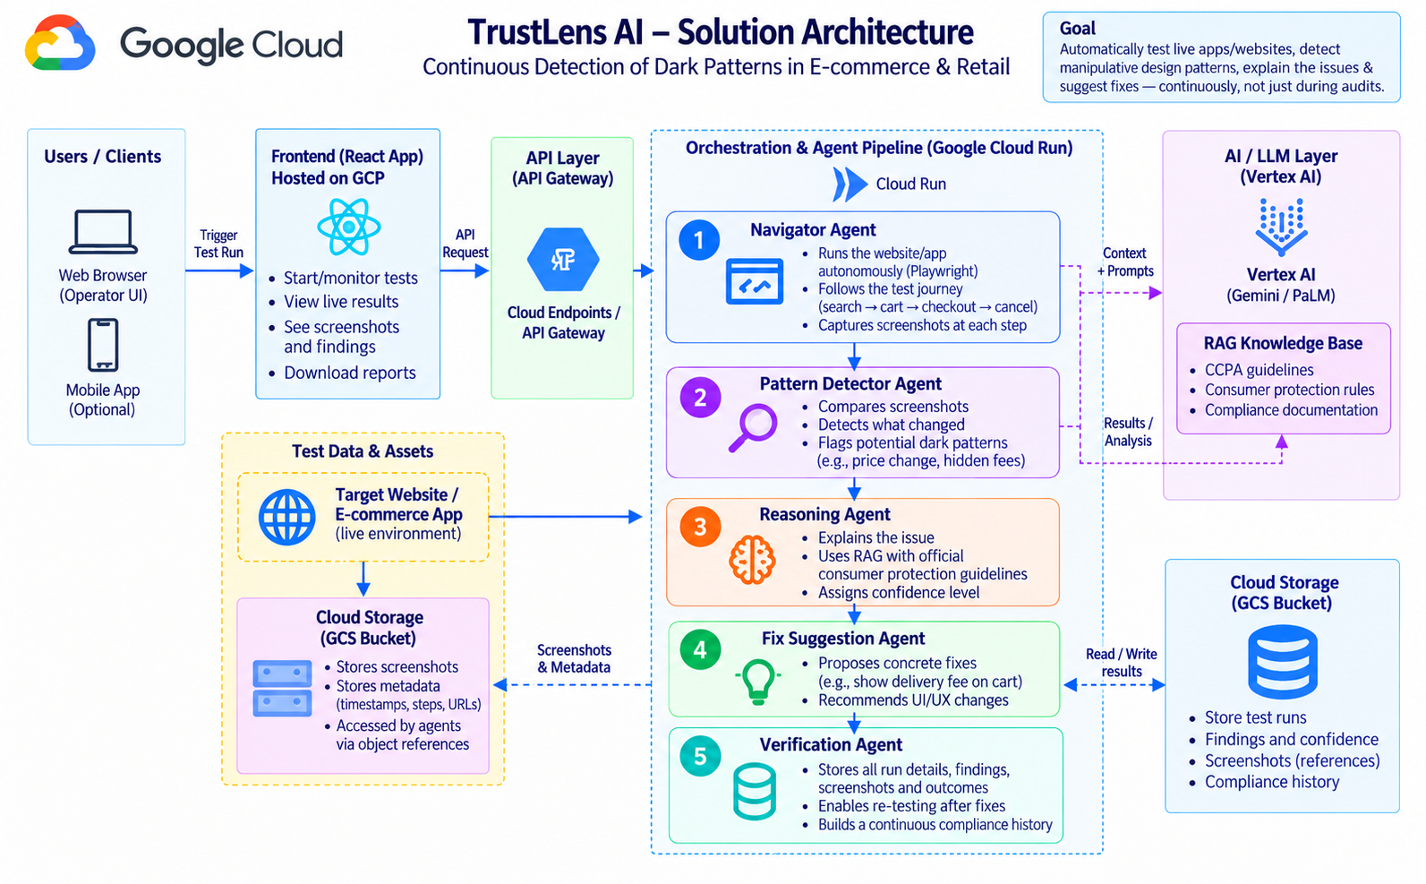
Solution Architecture

Slide 7
Technologies used in the solution
Google Cloud
Application stack
On the roadmap
Cloud Run
FastAPI backend and Navigator job
Gemini on Agent Platform (Vertex AI)
Vision, reasoning, suggestion fixes
Cloud Storage
Evidence and CCPA corpus, runs, findings, trail, inventory data
Artifact Registry
Storing the docker image
IAM + Secret Manager
Service Account, access and secrets
React
Operator dashboard
FastAPI (Python)
Backend and orchestration
Playwright + Chromium
Scripted customer journey
PDF + JSON
Report and certificate
Cloud Scheduler
Release-pipeline re-tests
BigQuery
Analytics across platforms
Jira, ServiceNow
Live ticket sync
Gemini exploration
Navigation without a script
Theme: Retail & Commerce, intelligent customer and business experiences, built on Google Cloud.

Slide 8
Estimated implementation cost
Service | Cost driver | Expected at prototype scale | Per run cost | 100 runs per month
Cloud Run | API requests and one Navigator job per run | Low: short jobs, scales to zero | under $0.01, mostly inside free tier | negligible
Gemini on Vertex AI | ~10 screenshots plus text per run; reasoning and fix calls | Main variable cost; grows with runs | about $0.05 (about ₹4 to 5) | about $5
Cloud Storage | Screenshots, PDF reports, CCPA corpus | Low: small files per run | negligible | negligible
IAM + Secret Manager | Service accounts and secrets | Negligible | negligible | negligible
No fixed cost
Indicative only
No licences or servers to run: every service above is serverless and pay-per-use.
Validate with the Google Cloud pricing calculator once run volume and storefront count are fixed.

Slide 9
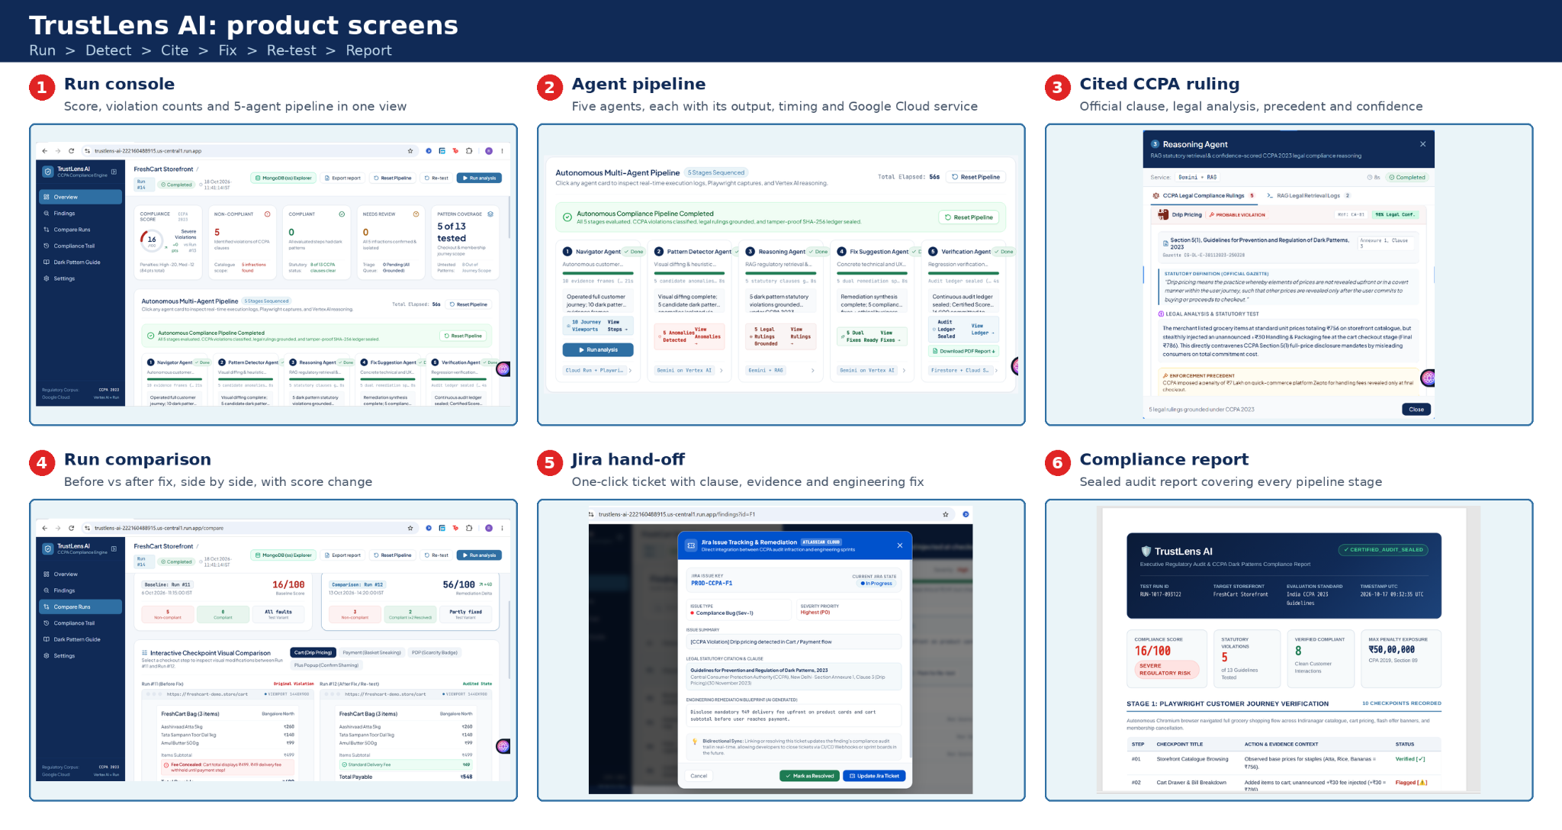
Snapshots of the prototype

Slide 10
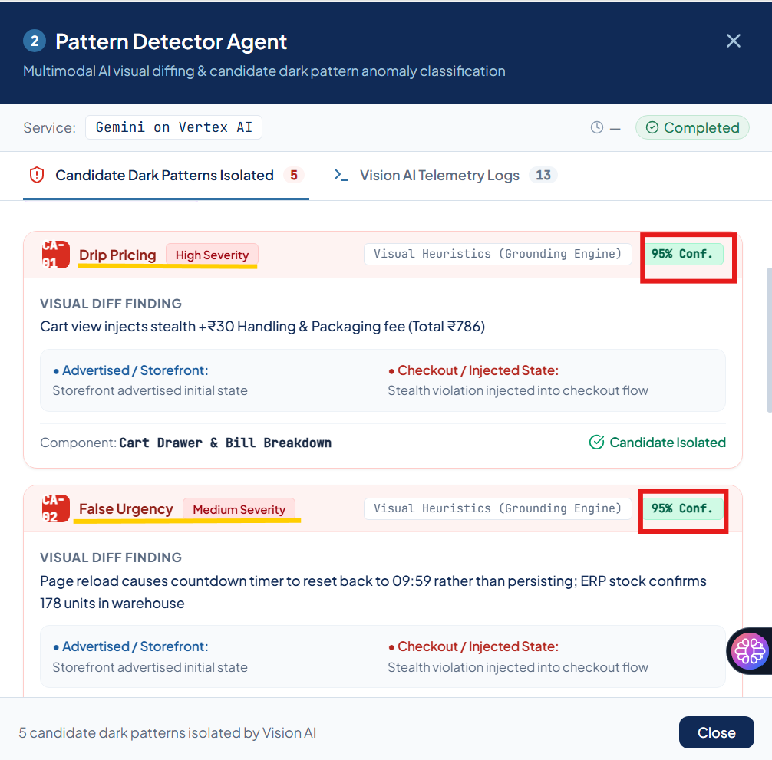
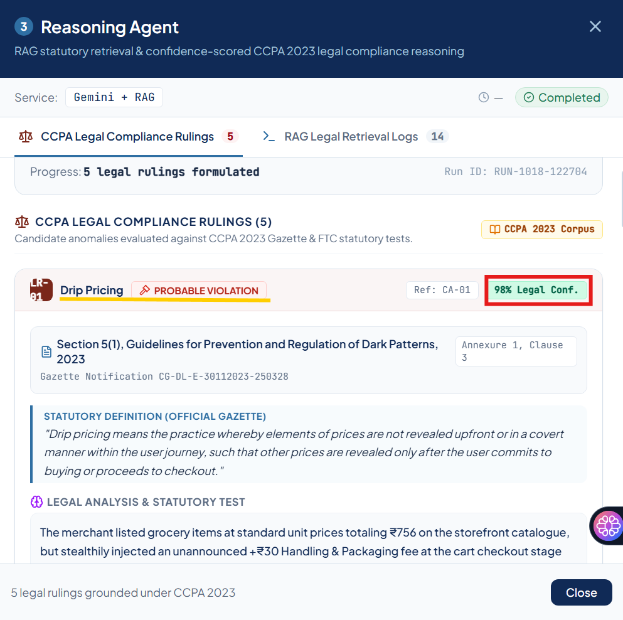
Prototype Performance report/Benchmarking
40s – 2 min
92–95%
End-to-end run time: about 40 s on our demo, up to about 2 min for larger sites
Pattern Detector confidence when flagging candidate dark patterns
96–98%
5 of 13
Reasoning Agent legal confidence on each CCPA ruling
CCPA dark patterns tested across a 10-checkpoint customer journey

Slide 11
Future Development Scope
Additional details: scope and limits
Future development
Tested scope only. 5 of 13 patterns on one scripted journey. A 100/100 score means no violations found in that scope.
Decision support. Verdicts carry a confidence level for human review. Penalty figures are statutory ceilings (up to ₹10 lakh; ₹50 lakh for repeat), not predicted fines.
Demo integrations. The Jira hand-off and the inventory feed use mock data, not live Jira, ServiceNow or warehouse systems.
More patterns. Interface interference, nagging, trick questions and the rest of the 13 CCPA patterns.
Continuous runs. Cloud Scheduler plus a release-pipeline hook, so every deploy is re-tested.
Live integrations. Jira and ServiceNow ticket sync, and real inventory feeds.
Exploration mode. Gemini-driven navigation for sites without a scripted journey.
Scale and reuse. BigQuery analytics across platforms; other rulebooks (EU Digital Services Act, US click-to-cancel) and sectors such as travel, fintech and subscriptions.

Slide 12
Provide links to your:
GitHub Public Repository: https://github.com/rinkle-agarwal/AI-Builder-Hackathon
Demo Video Link (3 Minutes 26 seconds): https://drive.google.com/file/d/1I8Gp-BKTOZwSVJREOPX0J63peJjQ8ac8/view?usp=sharing
Final Product Link: https://trustlens-ai-222160488915.us-central1.run.app/
How judges can test the demo (no login needed)
1
Open the product link
2
Choose a storefront
3
Start a run
The demo has no authentication or login: open the link and the dashboard loads.
Run the test storefront with dark patterns, then the fixed version. The demo html stores can be selected after the run analysis button. Both test HTML files are in the repo as well.
Watch the five stages, open the findings, compare the two runs and download the output report.

Slide 13


